Slide 1

The Balena IoT Ecosystem

Slide 2
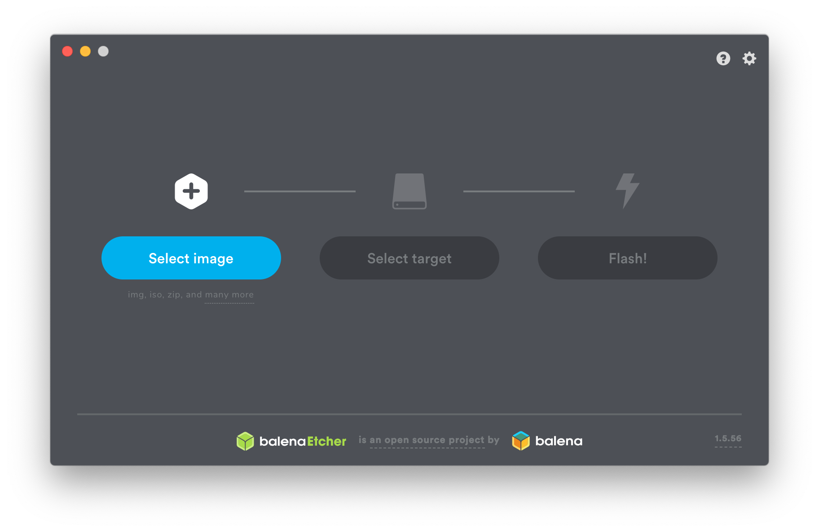
Notes:
I suspect there are some Etcher users in the audience.

Slide 3
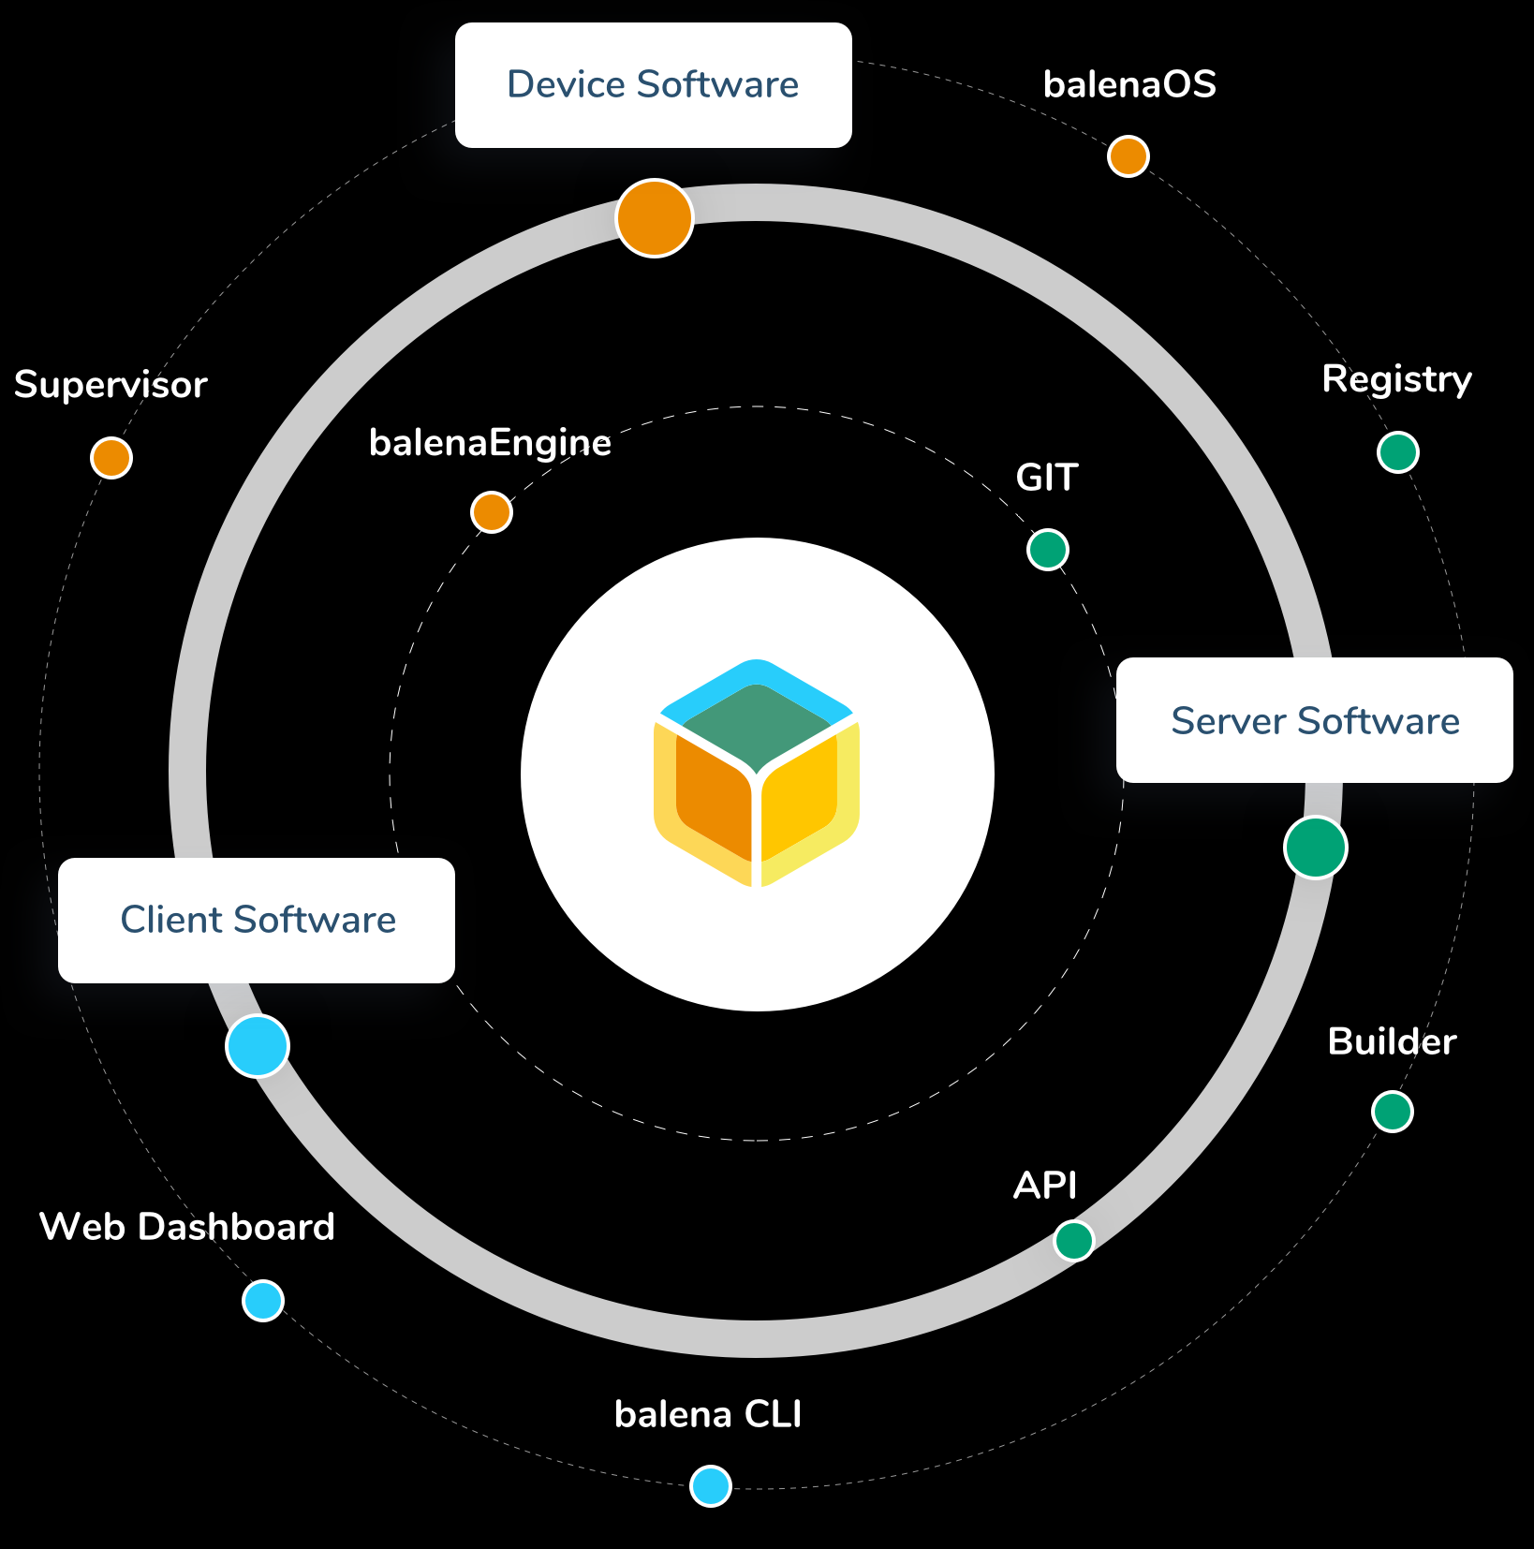
The Balena Ecosystem is Much More...
balenaCloud
balenaHub
balenaFin
EtcherPro
openBalena
balenaEngine
balenaOS
balenaLabs

Slide 4
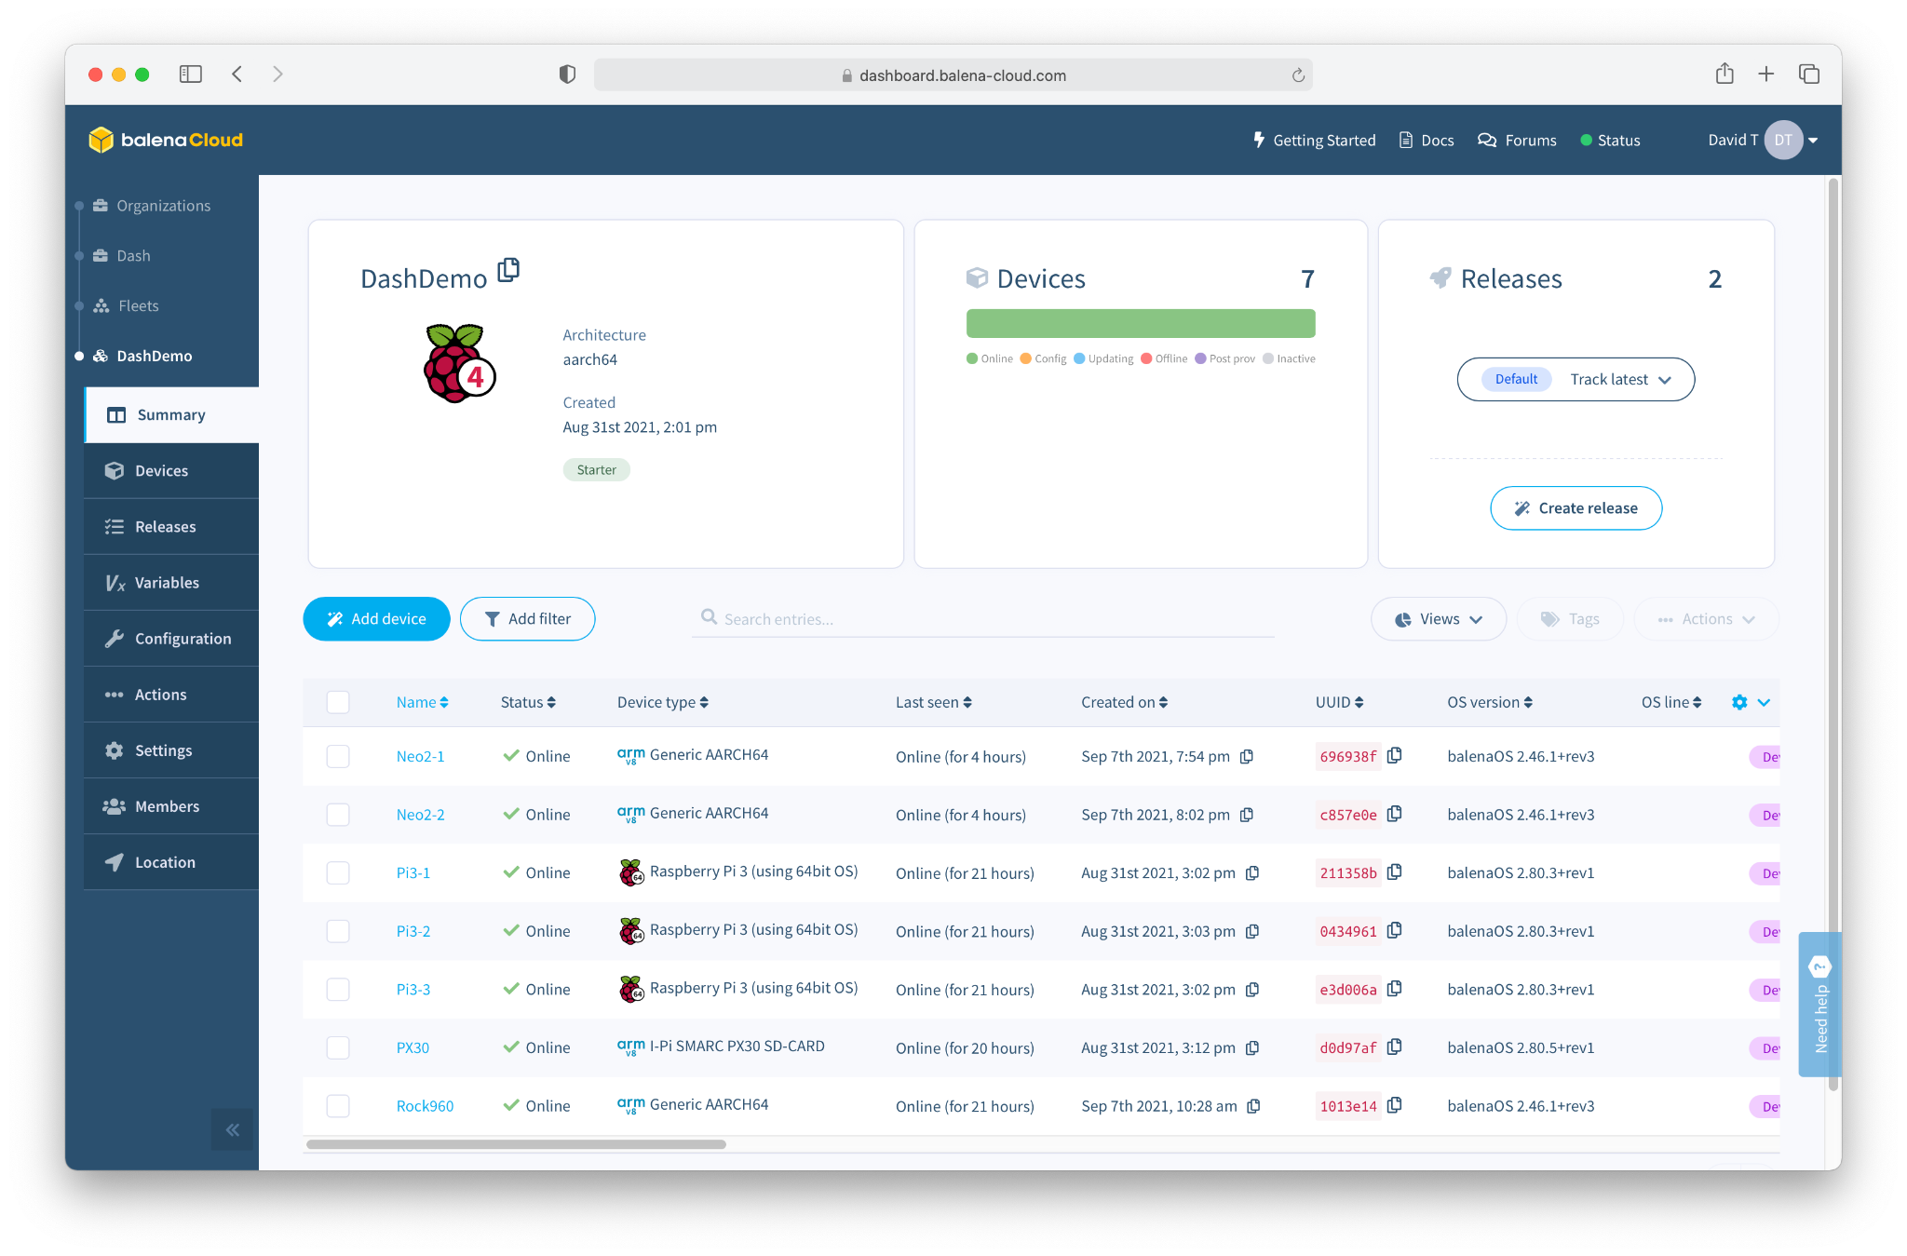
Software
balenaCloud
“Platform built to develop, deploy, and manage fleets of connected devices at scale.”

Slide 5
What do we mean by IoT “Fleet Management”?

Slide 6
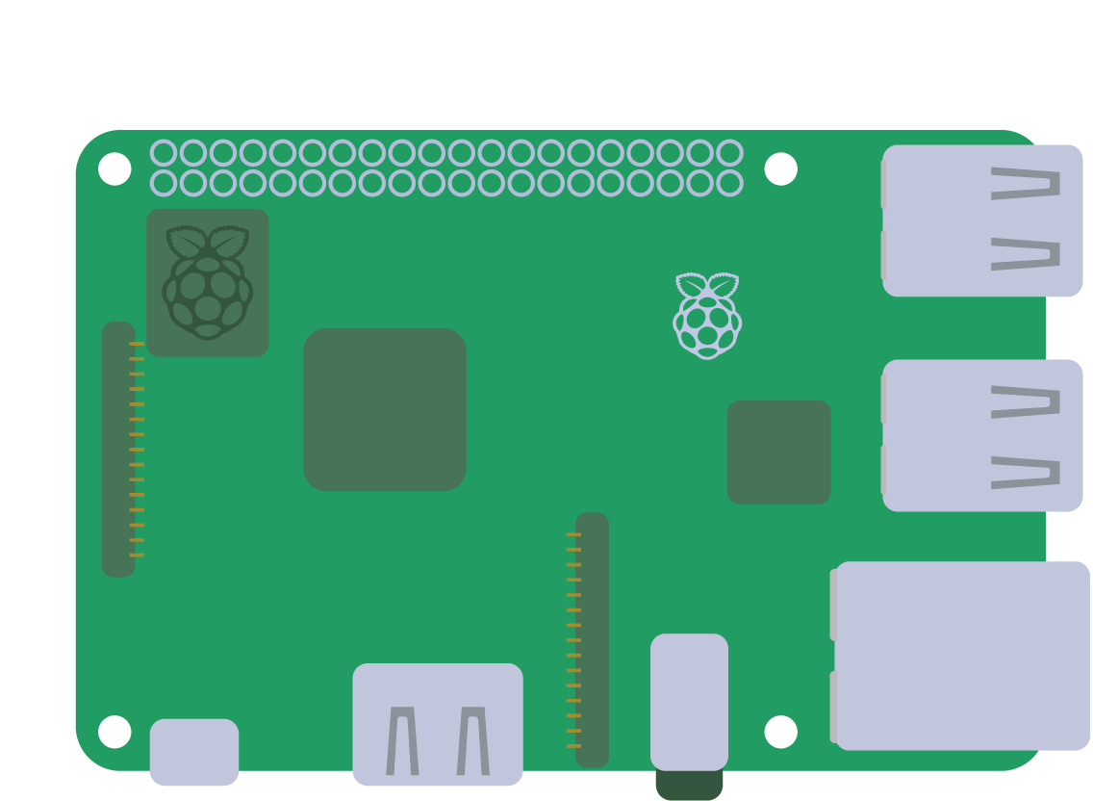


Slide 7
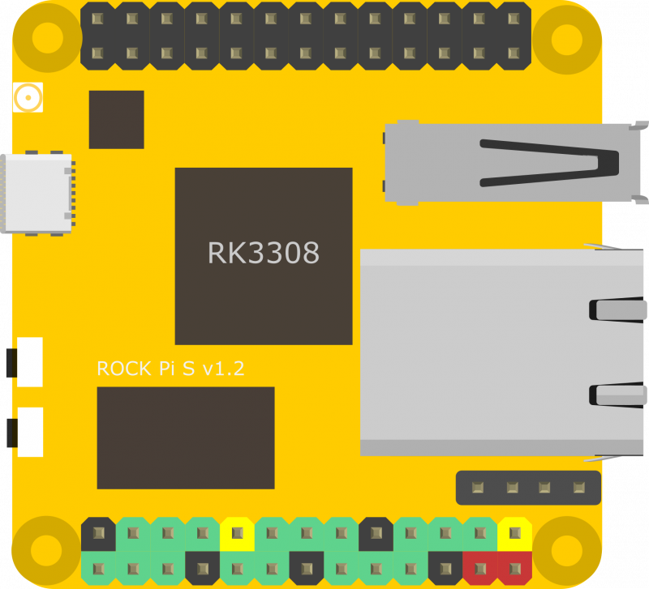
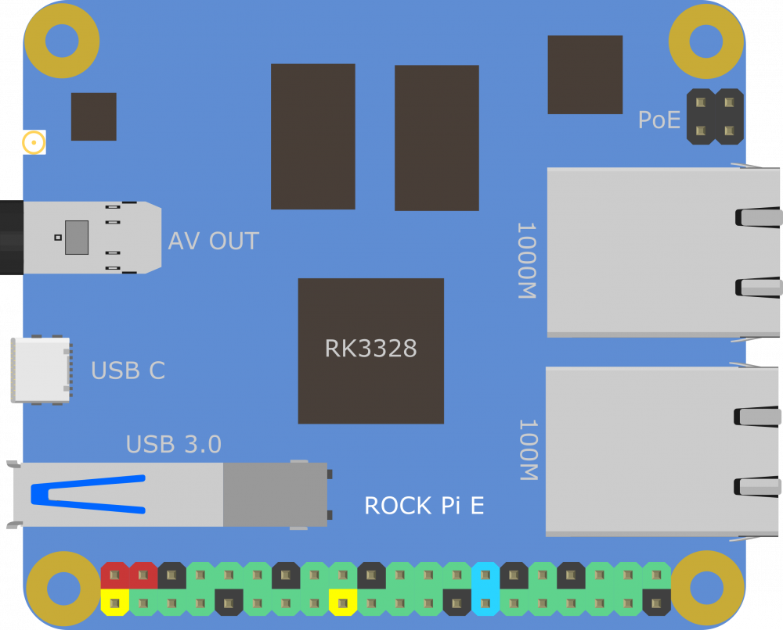
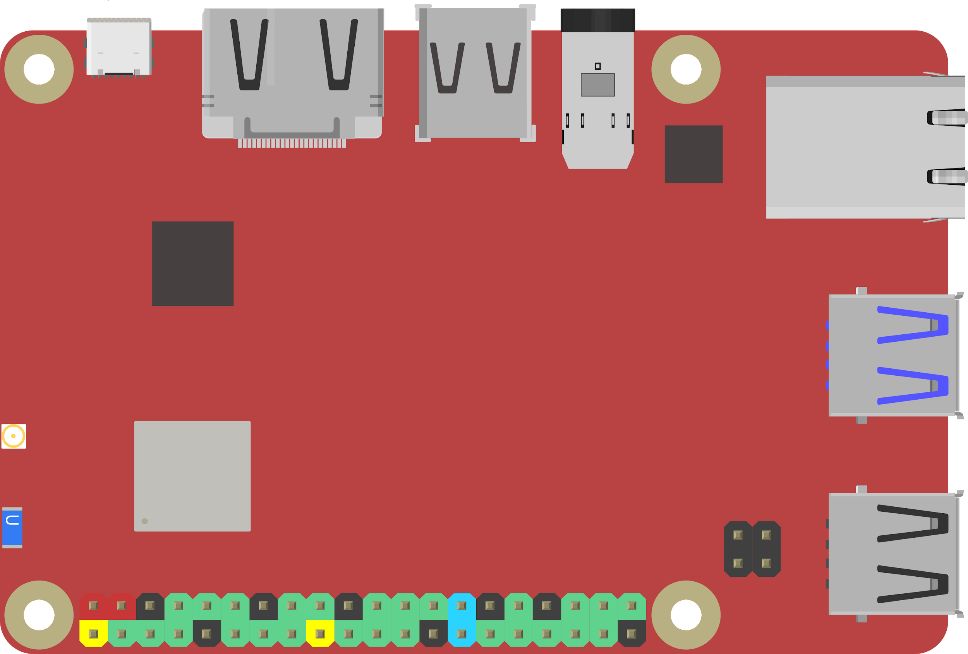
Notes:
48

Slide 8
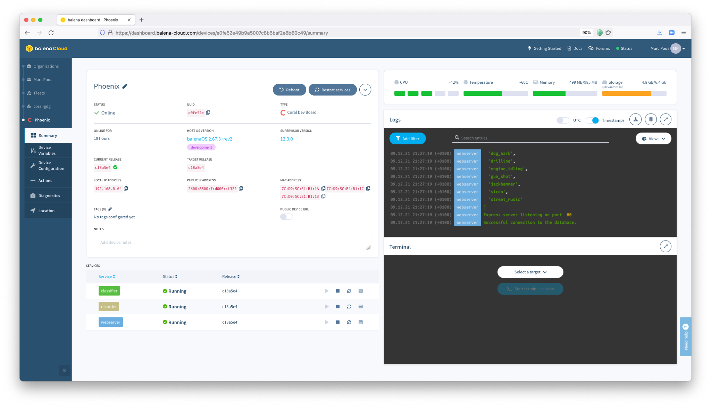

Slide 9
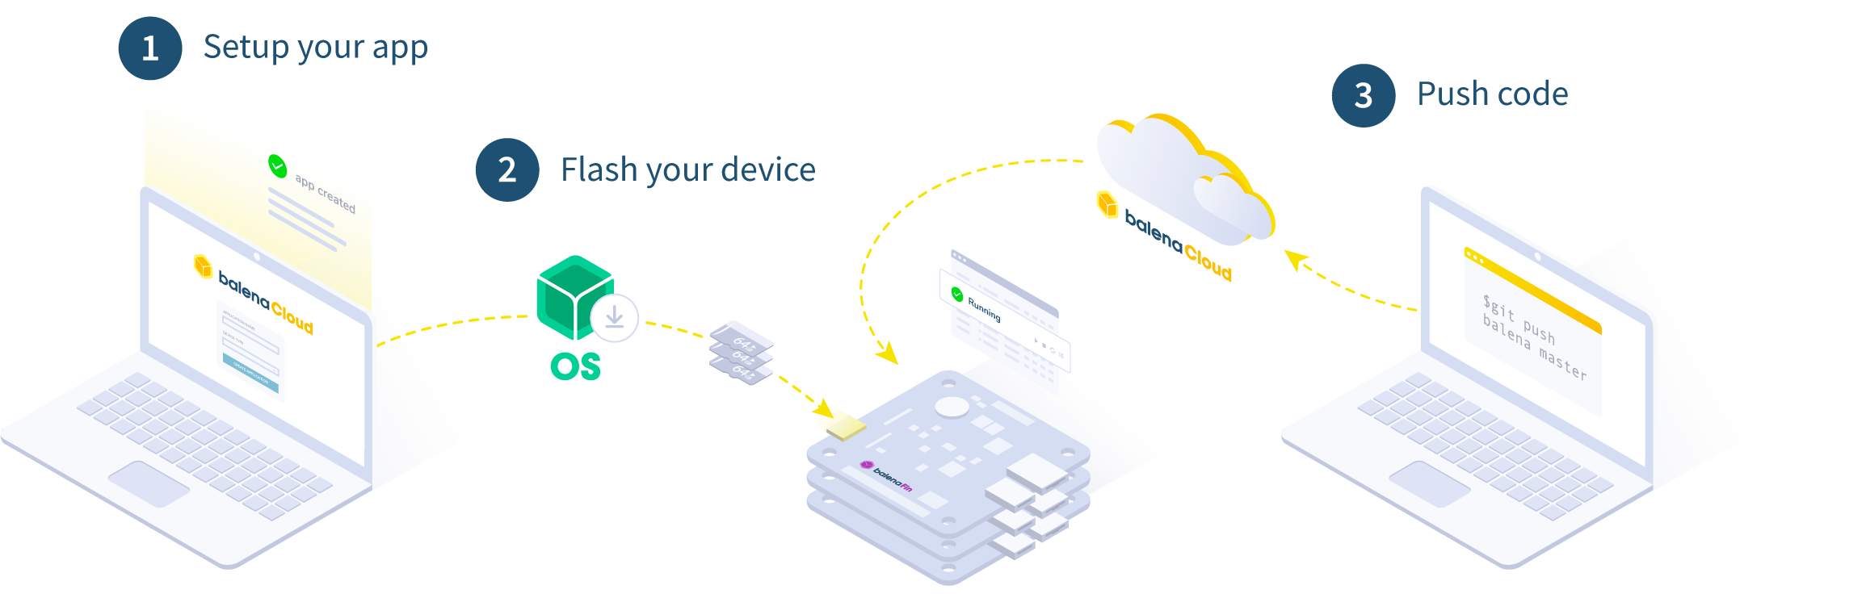
How it works

Slide 10
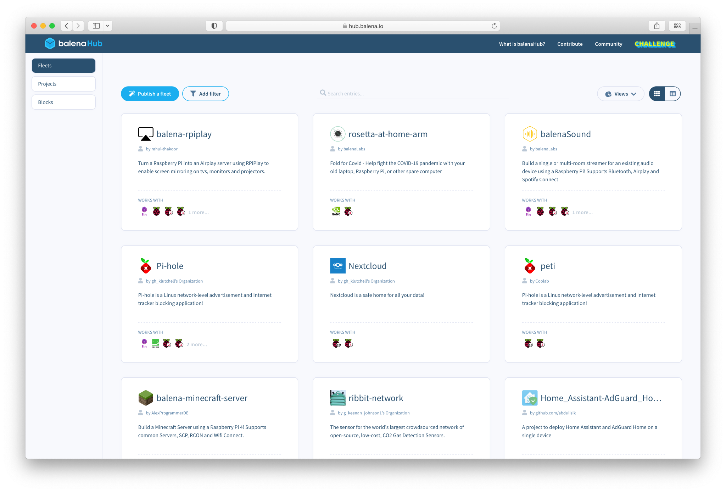
Software
balenaHub
“An easier way to find and publish fleets and projects for edge devices”

Slide 11
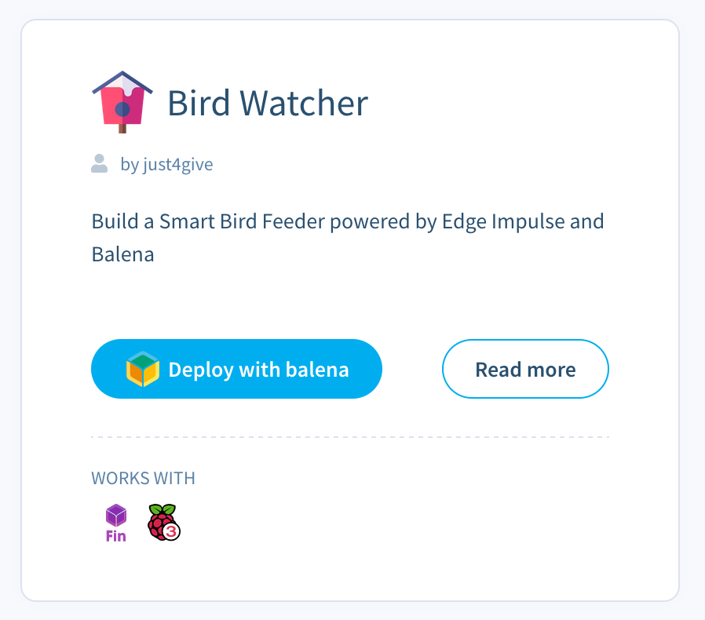
Notes:
Our stack addresses pain points that inhibit entry to the field
We have created the technology that can bootstrap an industry
We need a way to get it into the hands of the users
Allow people to build upon our learnings and avoid starting from scratch
---
Lower the barrier to entry
Give everyone the tools necessary to succeed in this space
Provide a smooth path from beginner to a successful app/business
Allow more fleet owners to get started; make more ideas viable - who knows what people will come up with
It’s hard to explore and test ideas
---
Initiate an exponential growth process
Build positive feedback loops
Seed and cultivate network effects and virality, between devices as well
Encourage and facilitate contribution
Expose us to more fleet owners (including potential fleet owners)

Slide 12
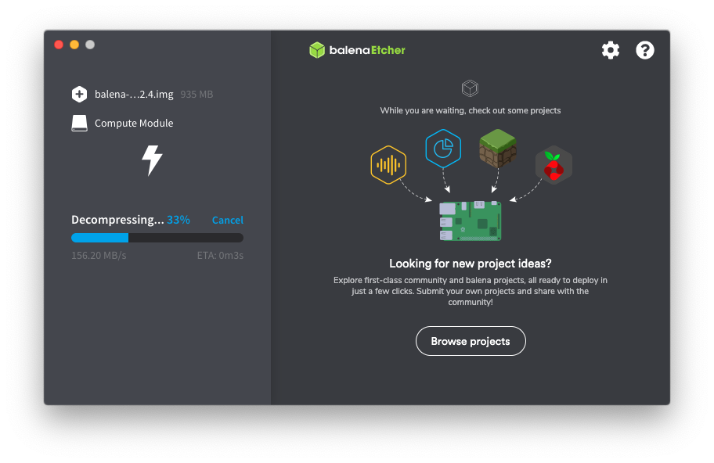
Notes:
Our stack addresses pain points that inhibit entry to the field
We have created the technology that can bootstrap an industry
We need a way to get it into the hands of the users
Allow people to build upon our learnings and avoid starting from scratch
---
Lower the barrier to entry
Give everyone the tools necessary to succeed in this space
Provide a smooth path from beginner to a successful app/business
Allow more fleet owners to get started; make more ideas viable - who knows what people will come up with
It’s hard to explore and test ideas
---
Initiate an exponential growth process
Build positive feedback loops
Seed and cultivate network effects and virality, between devices as well
Encourage and facilitate contribution
Expose us to more fleet owners (including potential fleet owners)

Slide 13
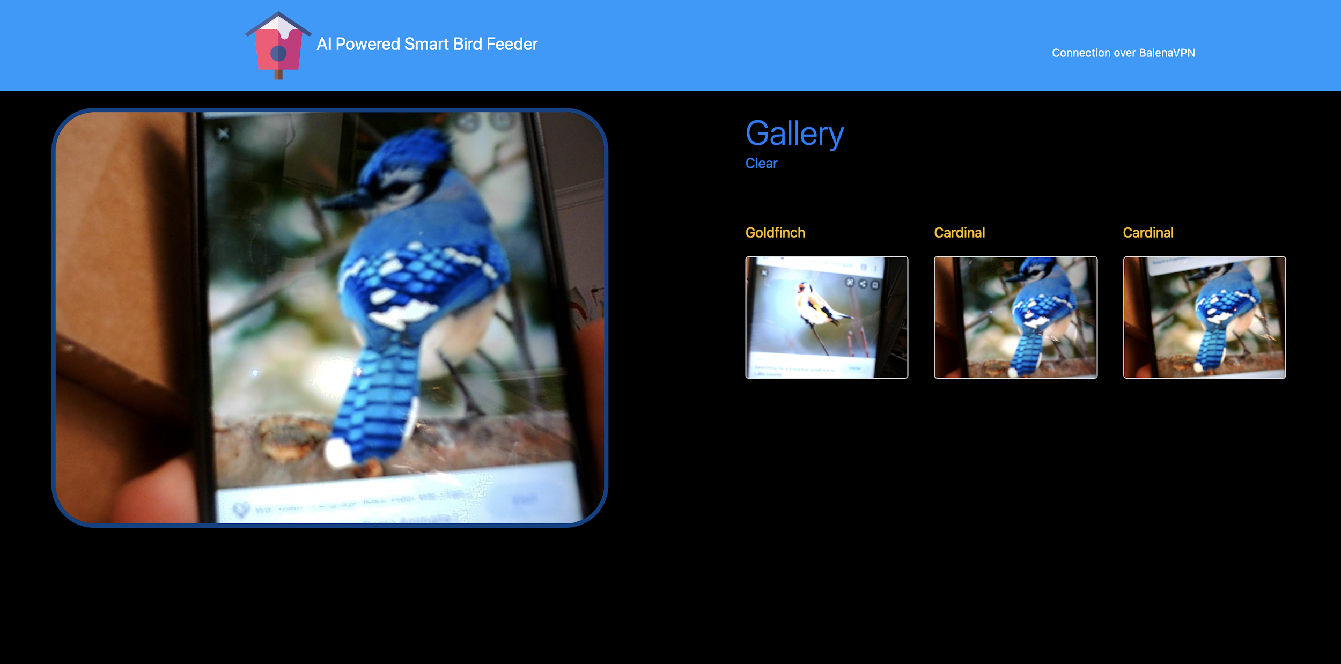
Notes:
Our stack addresses pain points that inhibit entry to the field
We have created the technology that can bootstrap an industry
We need a way to get it into the hands of the users
Allow people to build upon our learnings and avoid starting from scratch
---
Lower the barrier to entry
Give everyone the tools necessary to succeed in this space
Provide a smooth path from beginner to a successful app/business
Allow more fleet owners to get started; make more ideas viable - who knows what people will come up with
It’s hard to explore and test ideas
---
Initiate an exponential growth process
Build positive feedback loops
Seed and cultivate network effects and virality, between devices as well
Encourage and facilitate contribution
Expose us to more fleet owners (including potential fleet owners)

Slide 14
Software
Etcher
“A cross-platform tool to flash OS images onto SD cards and USB drives safely and easily.”

Slide 15
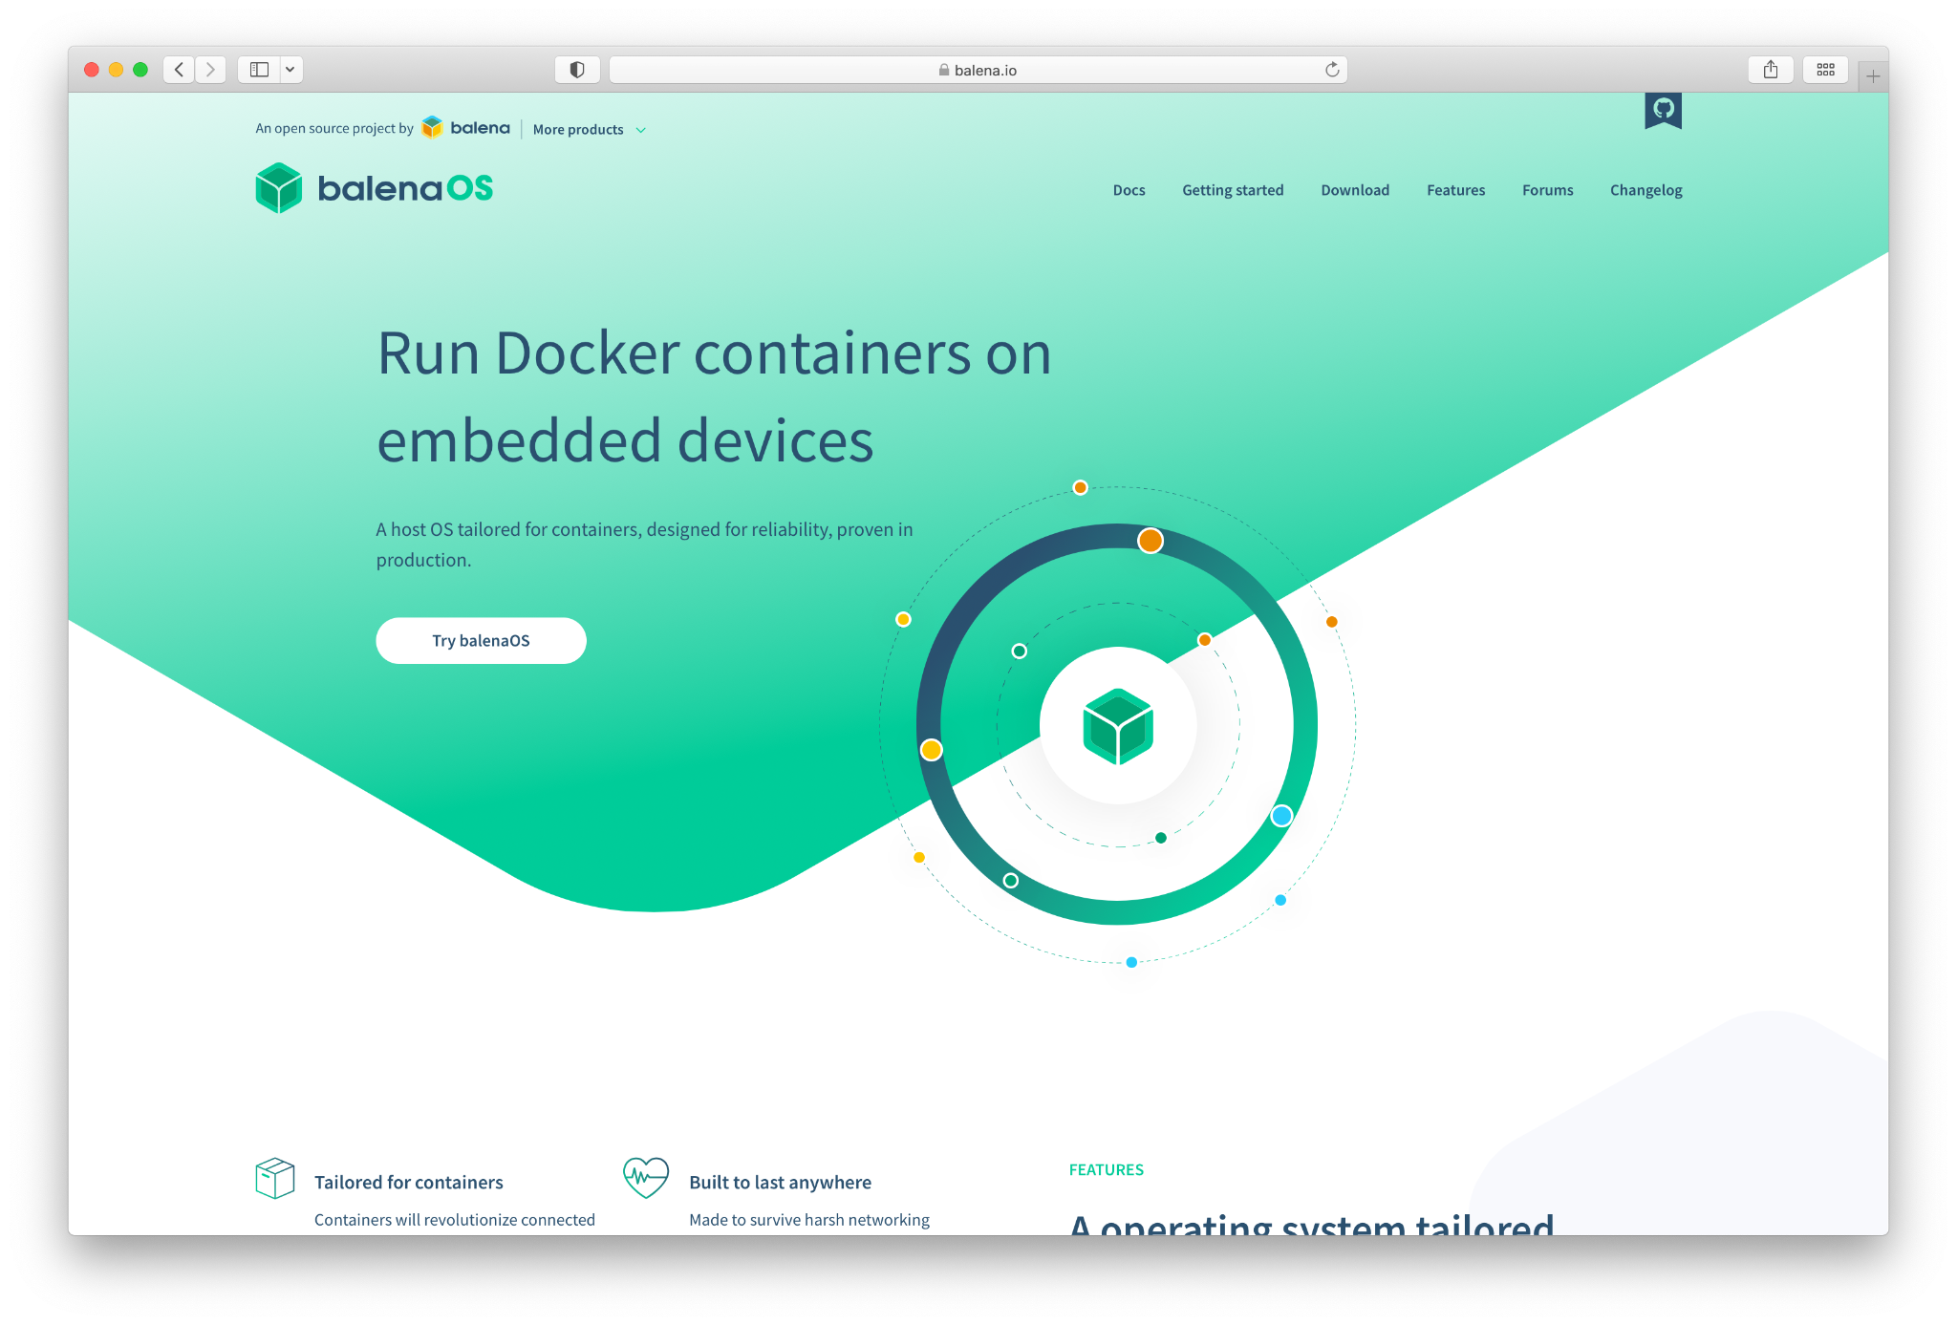
Software
balenaEngine
Open source container runtime based upon Moby
balenaOS
Open source IoT operating system based on Yocto

Slide 16
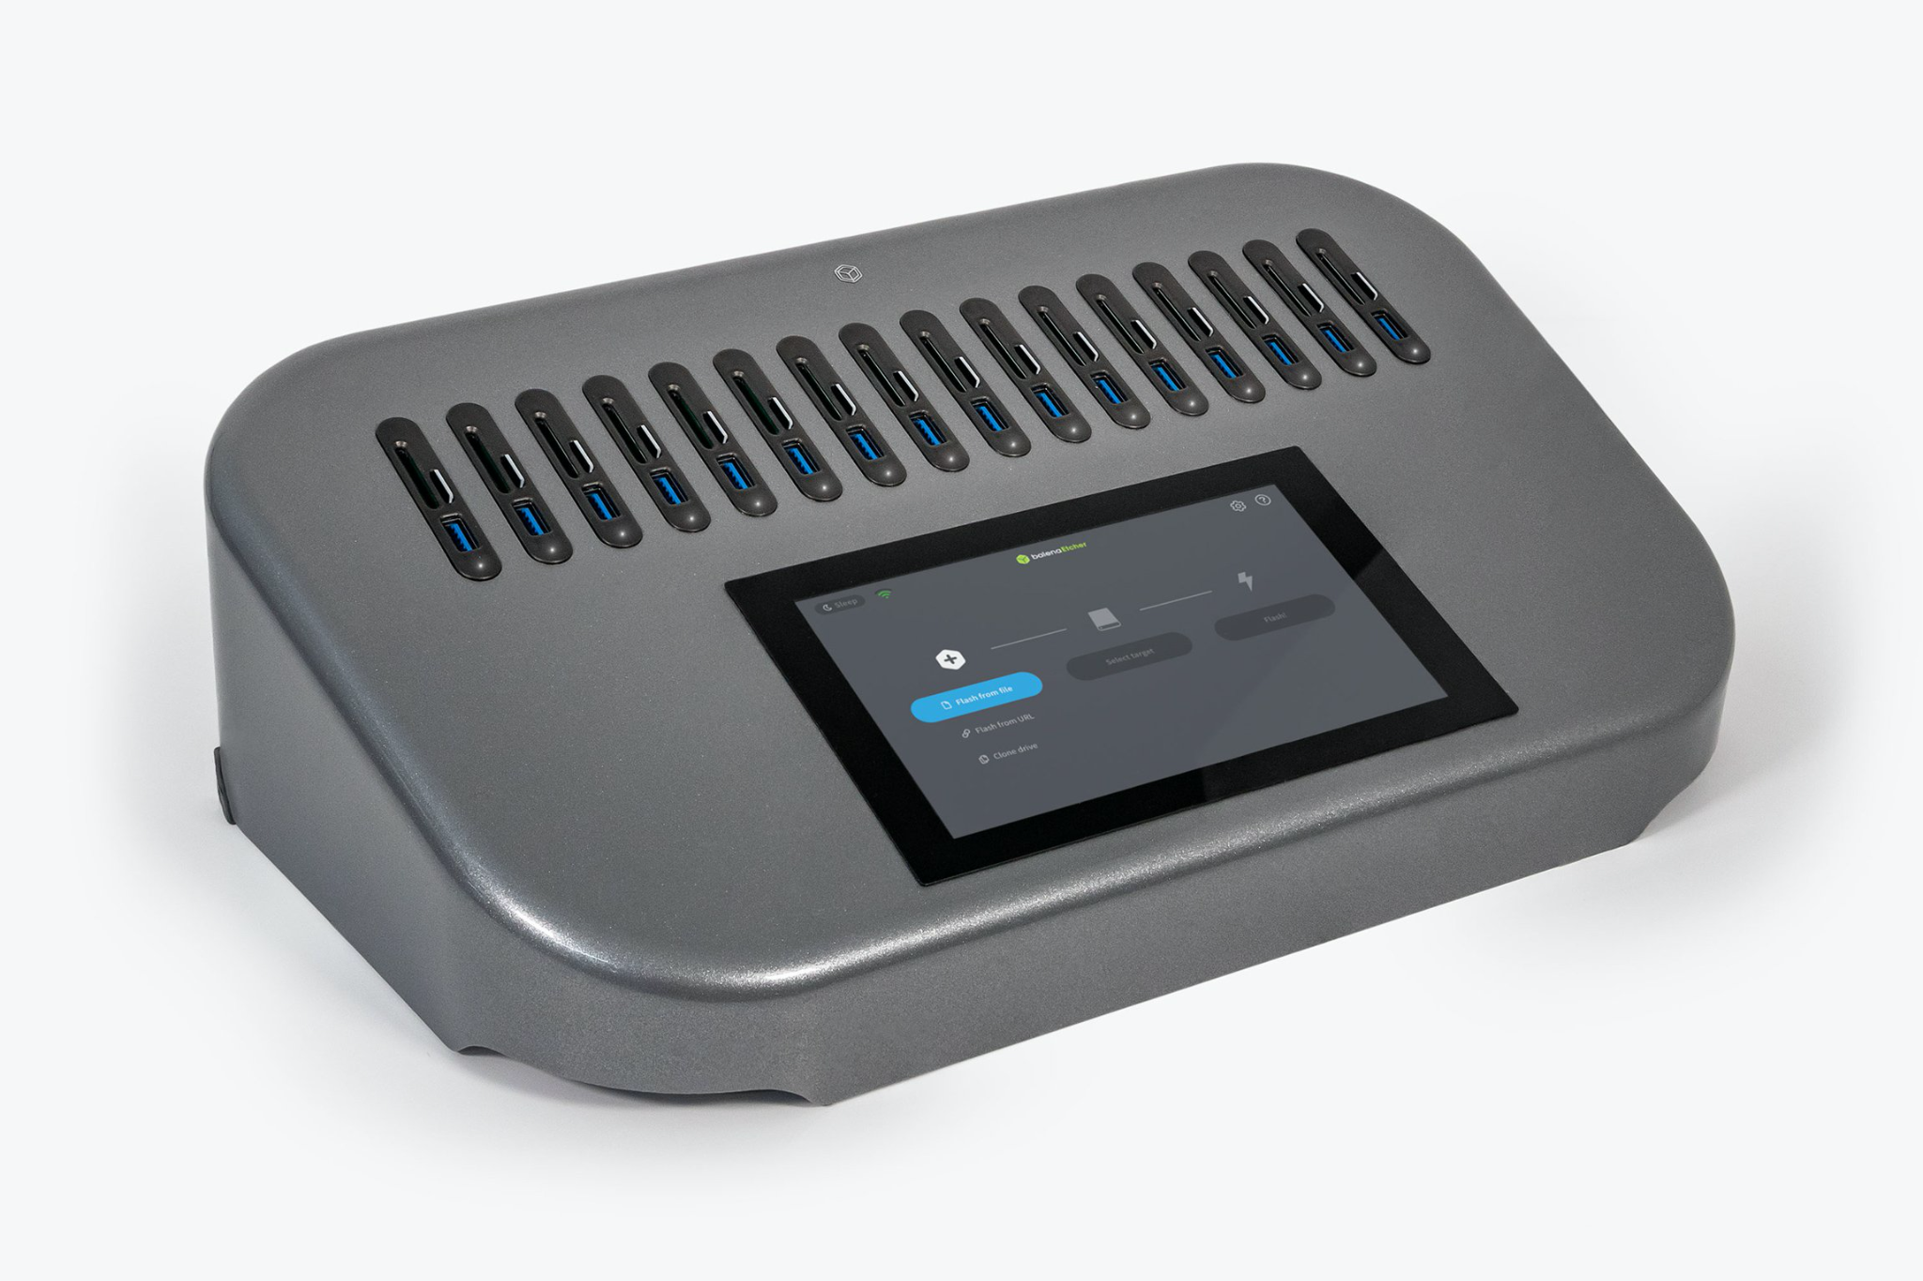
Hardware
EtcherPro
“Built to write data flawlessly to multiple devices simultaneously”

Slide 17
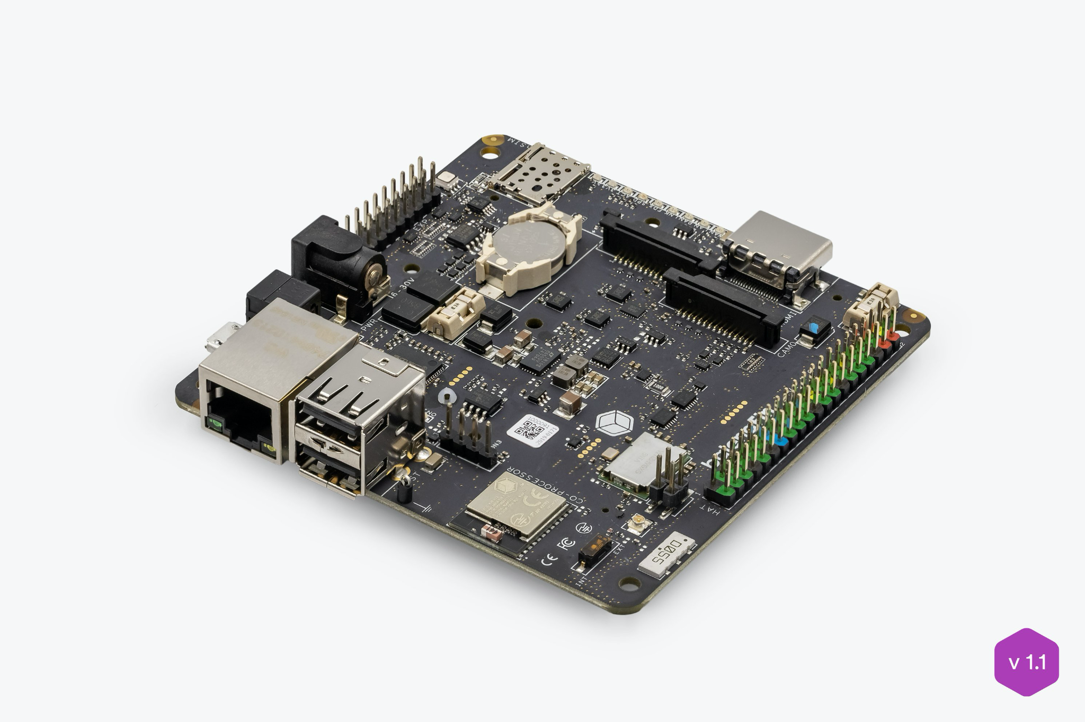
Hardware
balenaFin
“A professional carrier board for the Raspberry Pi Compute Module”

Slide 18
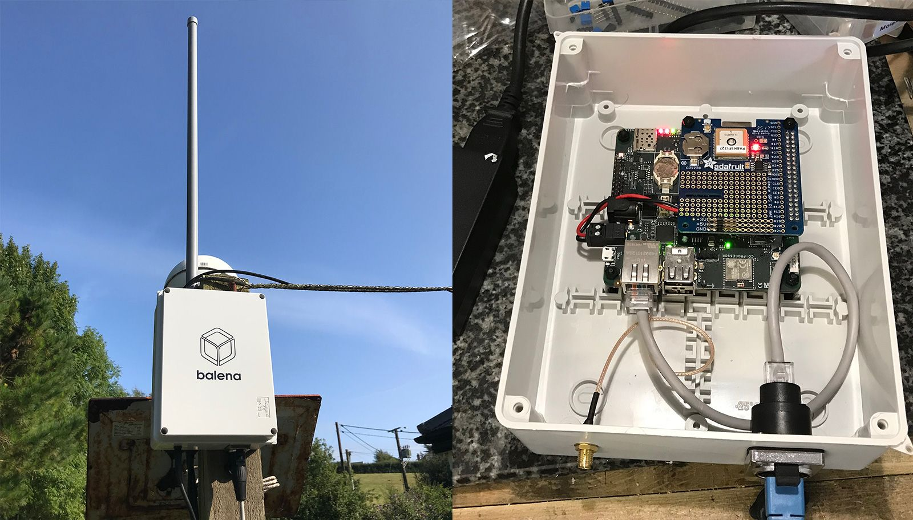
Hardware
balenaFin
“A Raspberry Pi Compute Module carrier board that can run all the software that the Raspberry Pi can run, but hardened for deployment in the field”

Slide 19




balenaLabs

Slide 20
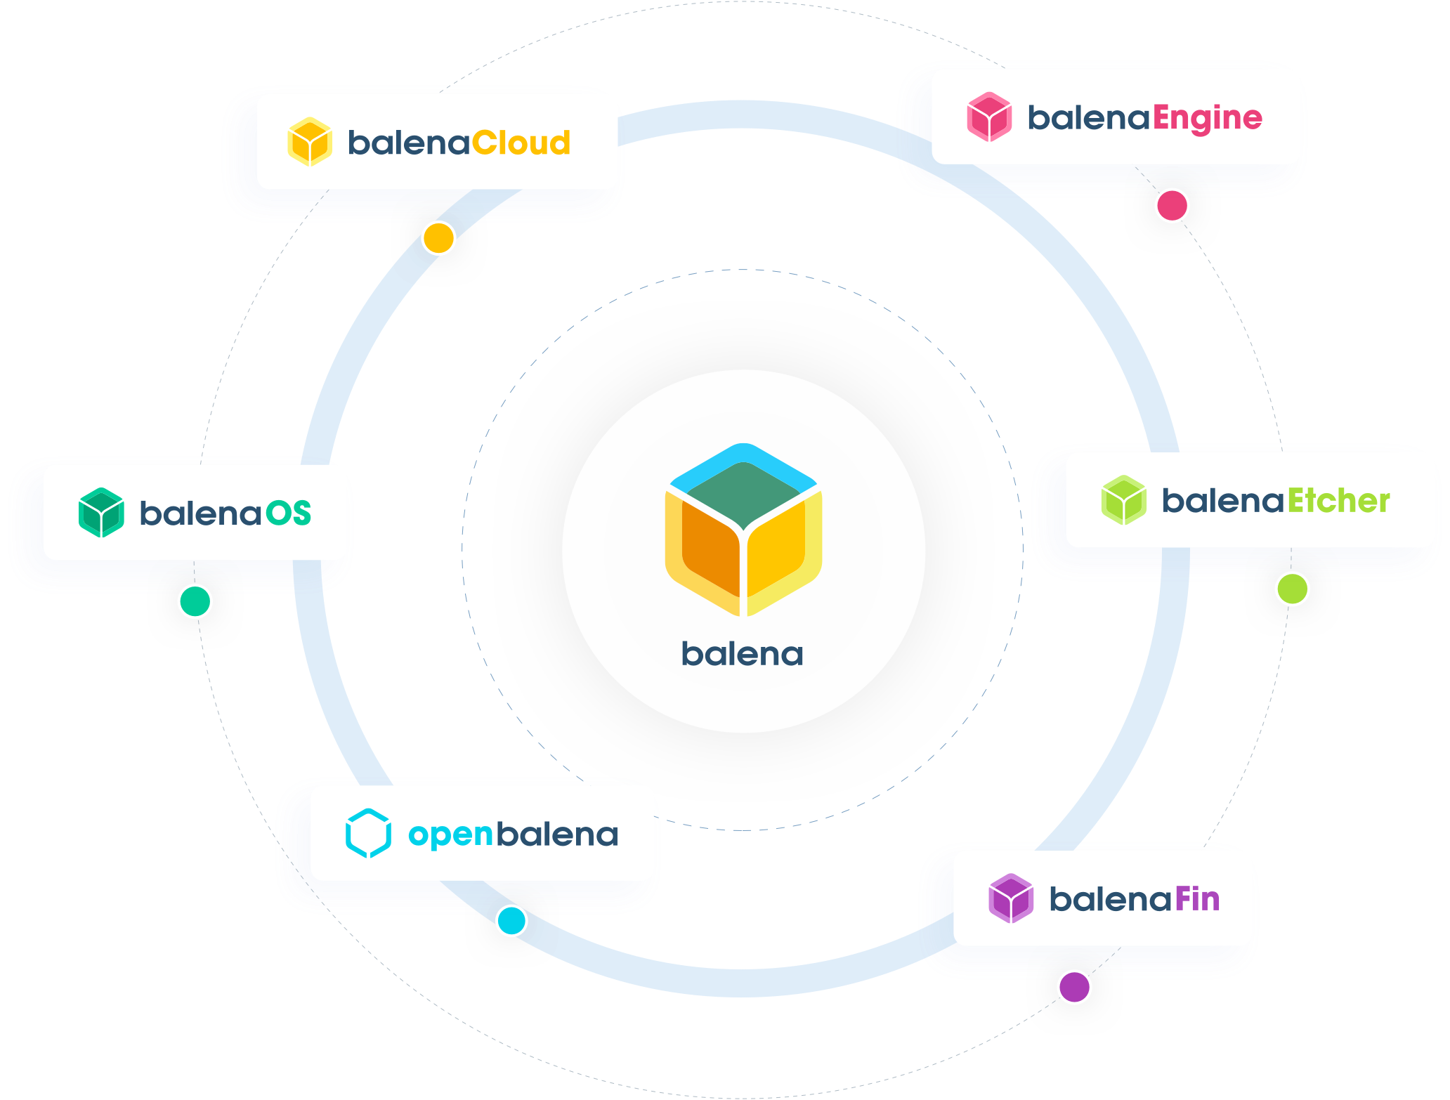

Slide 21
Questions?

Slide 22


